Slide 1
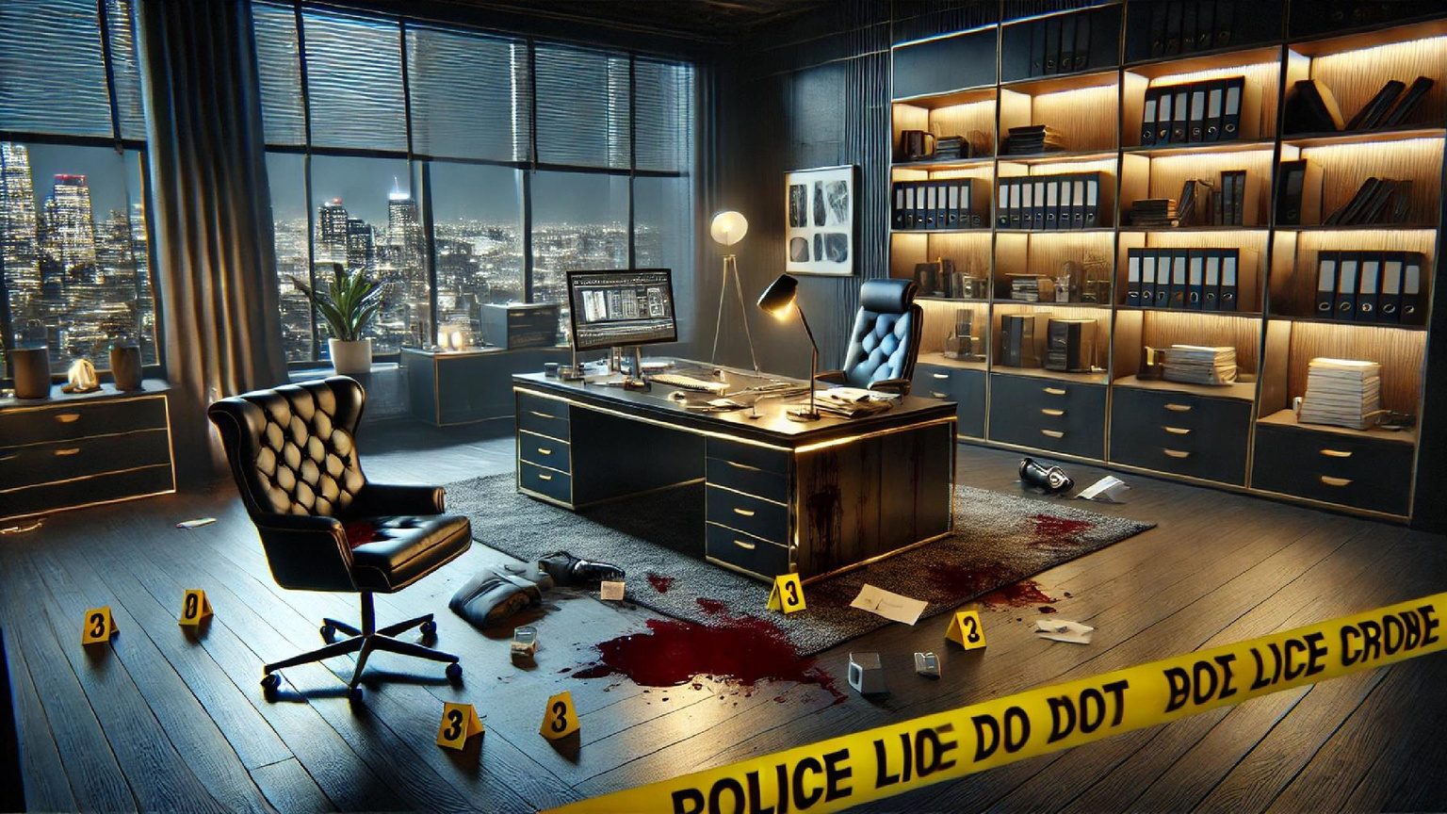

Murder in the Office
.
MURDER MYSTERY EPW

Slide 2

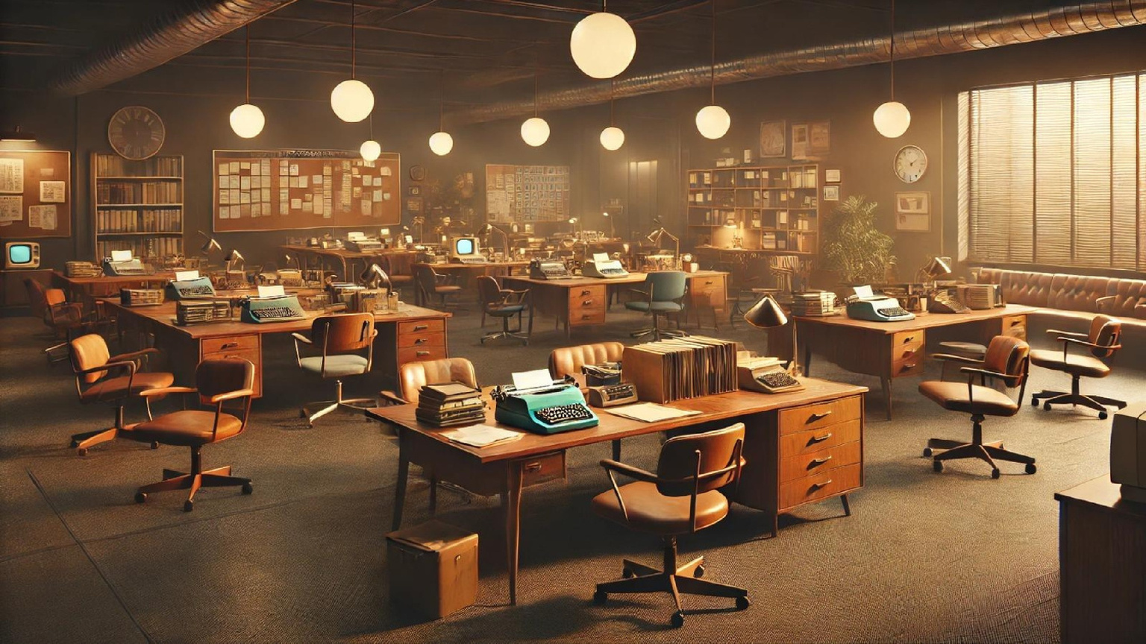

Atmosphere
Bright, crowded 70’s Office.
Loud, Lively, and nervous.

Slide 3
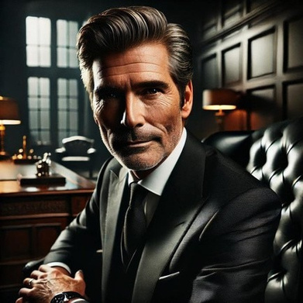
Victim
Age:53
Personality: Ambitious, wealthy, and hypocrite
Background: had been married for 22 years and father of two. He is the CEO of a successful tobacco company
Milton Blacthorn

Slide 4
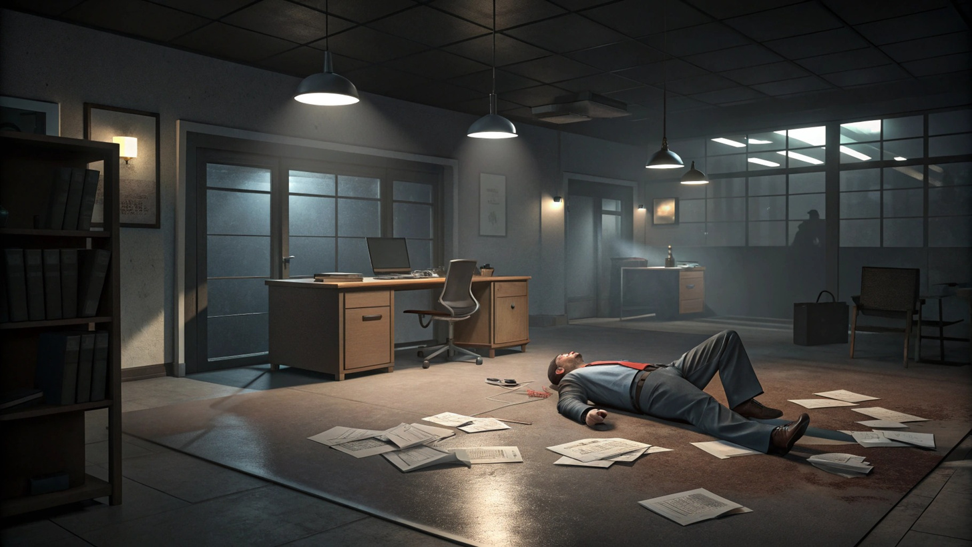
Milton seemed to have a perfect balance between work and family life.However, things
weren’t as flawless as they appeared…

Slide 5

Suspect 1 (the secretery)
Age:32
Personality: Hardworking, clumsy, and arrogant
Background: Had been Milton’s assistant for four years. Her prior experience with other successful companies ensured her quick hiring.
Bonny Harper

Slide 6
A minor mistake nearly cost her the job, leading to several heated arguments with Milton

Slide 7
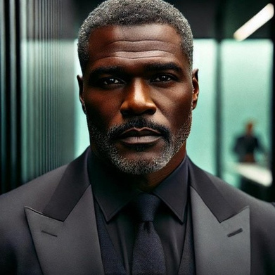
Suspect 2 (the bodyguard)
Age: 55
Personality:sporty, restless, greedy, and tough
Background: A former boxer, who became a bodyguard. Having grown up in a tough neighborhood, he faced a lot of difficulty by himself
Mac

Slide 8
He was also the only suspect authorized to carry a weapon

Slide 9
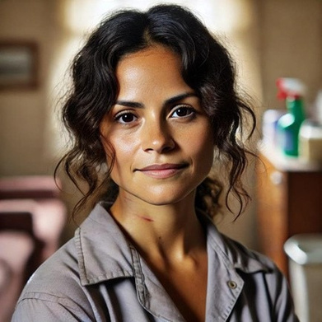
Suspect 3 (the cleaning lady)
Age:32
Personality: Shy, reliable, and polite
Background: Originally from a small city in Mexico, came to do U.S. To search for a job to help her family’s struggle.
Madison Alvarez

Slide 10
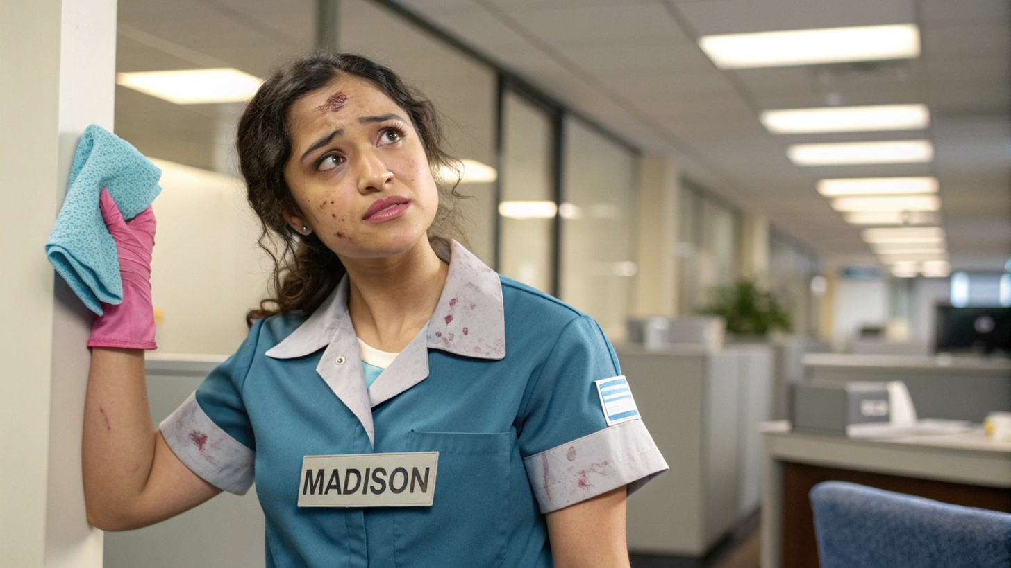
Over time, she was observed with numerous bruises
on her body…

Slide 11
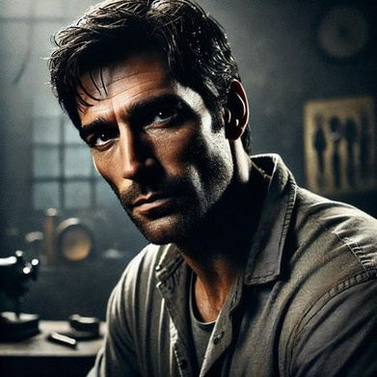
Suspect 4 (the technician)
Age:51
Personality: Jealous, talented, and patient
Background: Milton’s cousin, grew up like a brother to him due to family circumstances. However, resentment simmered after the family business passed to Milton instead of Marcus.
Marcus Blackthorn

Slide 12

Crime scene
The technician found the victim slumped at his desk, blood flowing from a neck wound. His clothes were soaked in blood, which continued to drip. Checking the neck and wrist, the technician confirmed there
was no pulse

Slide 13
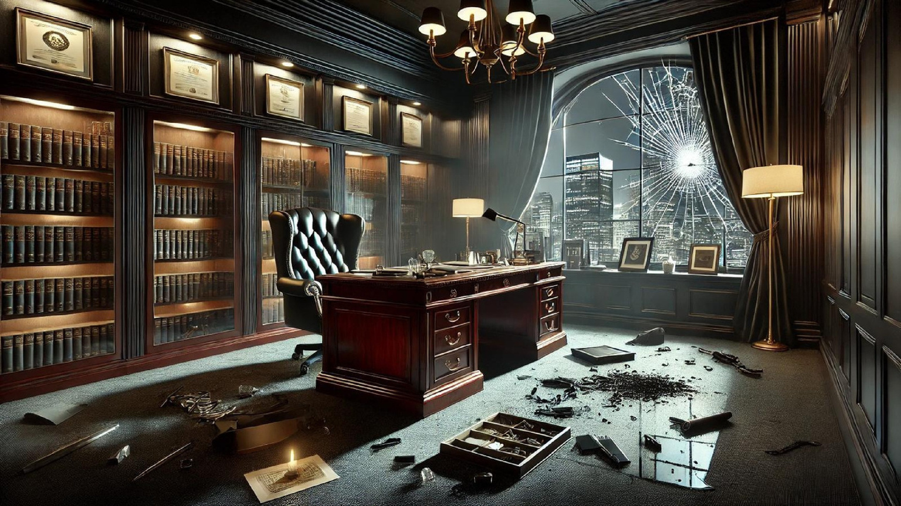
Crime scene
The overturned glass had severed wires connected to the room's surveillance system, leaving no video evidence of the crime.
No weapon was found at the scene, nor were there any suspects
present.

Slide 14
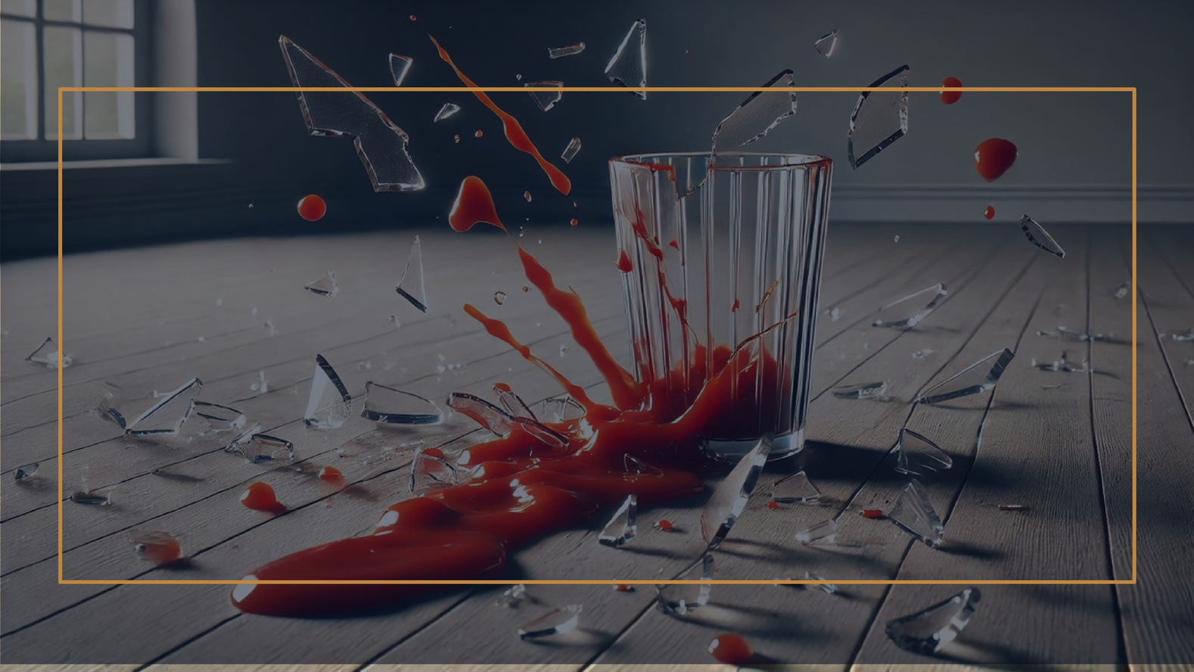
Who would have thought a man with so many accomplishments could harbor so
many enemies?

Slide 15
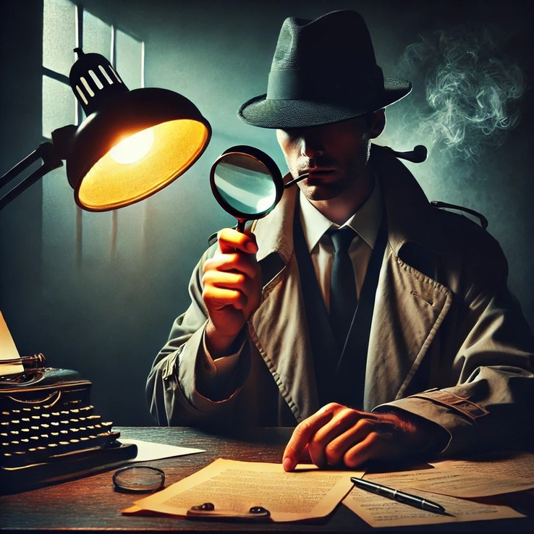
Clues & Red
herrings

Slide 16
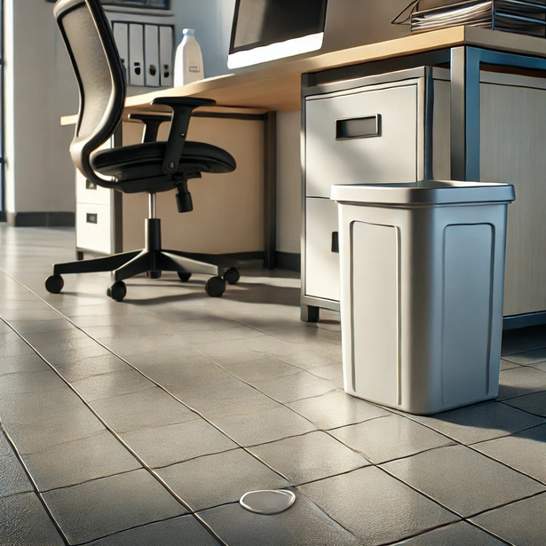
Detergent Drop
The detective followed a trail of faint detergent drops near the trash can where the blood-stained glass shards were found. The trail led toward the hallway and matched the brand Madison Alvarez used in her cleaning supplies. Madison explained she had been in a hurry to assist Ms. Harper with a faucet issue and hadn't noticed any spills.

Slide 17
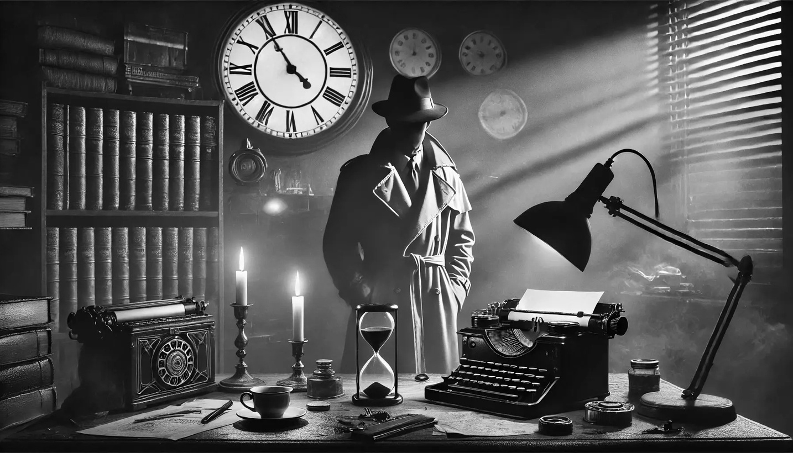

Detective: Ma'am, what was your relationship with your boss, Mr. Blackthorn? How long have you known each other?
Alvarez: Mr. Blackthorn is—was my boss for like... 4 years. He may
have been an angry man, but I loved him, and my family and I owe him
a lot. Detective: You two don’t get along very well for the other employees
in the office. Do you have anything to say about it?
Alvarez: No, it was nothing like that— Detective: Miss, it would be easier for me to investigate if you just told
me the truth.
Alvarez: ...sure. (Pauses) He—he would sometimes... make comments,
and there were moments when his behavior... (voice shakes) crossed
the line. But I didn’t think it would come to this... (trails off).
Interrogation

Slide 18
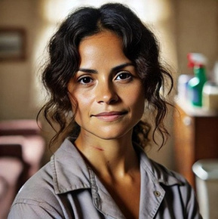
Detective: Where were you at the time of the incident, Ms. Alvarez? From what I heard, Blackthorn called you to his office before he died.
Alvarez: Yes, yes he called me. I was going to his office but had to
turn back to help Miss Harper. If only I were a little faster... if only I...
(Sobbing) None of this would have happened. Detective: Ms. Alvarez, I need you to stay calm for a moment. Where
exactly were you just before you helped Ms. Harper? Was it near the
CEO's office? Alvarez: No... I was mopping the floor downstairs. Then I went directly
to Ms. Harper.
Detective: I see, Ms. Alvarez. Do you have any witnesses to
corroborate your statement?
Alvarez: Yes, you can ask Ms. Harper, sir. She... she saw me right
before I went to help her.
Interrogation

Slide 19
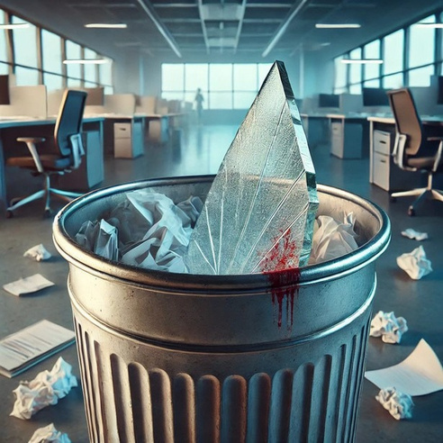
Broken, Blood-Stained Glass Shards
In the heart of the investigation, a critical clue emerged: broken, blood-stained glass shards found in the trash bin beside the secretary’s desk.
Why were they there? Did the secretary witness
something, or was she involved in the incident?
The presence of blood suggested a struggle, while the
disposal of the shards hinted at a hurried attempt to hide
evidence.

Slide 20
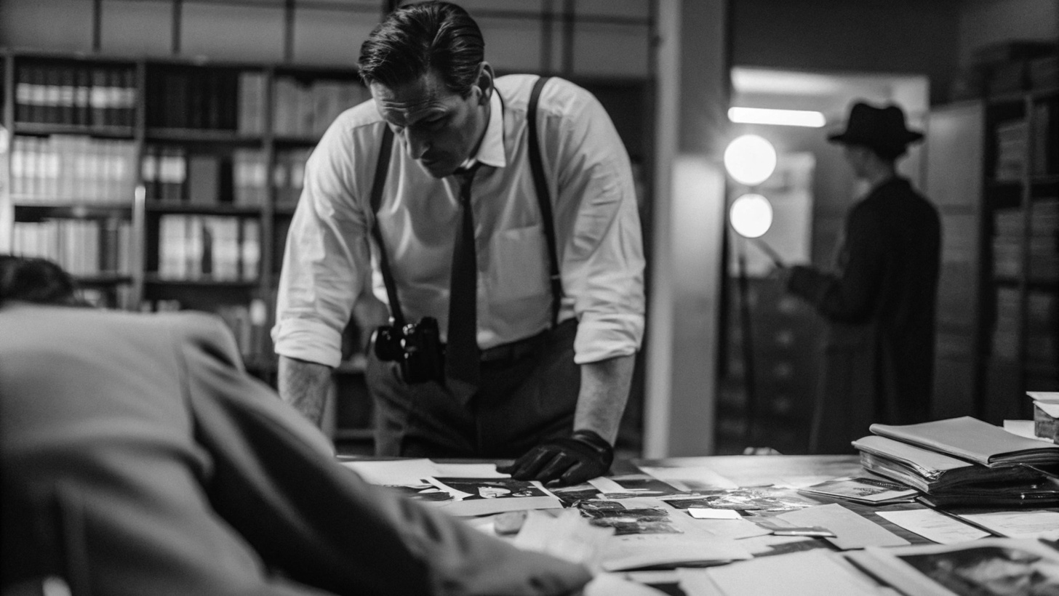

Detective: How was your relationship?
Bonny Harper: I… I was Milton’s secretary for four years. W-We
didn’t always get along. There were times he got furious because of
my mistakes, and… he even threatened to fire me a few times. Detective: Do you have any defense to broken, blood-stained glass
shards found in the trash bin beside your desk?
Bonny Harper: W-What? Blood-stained glass? I-I don’t know
anything about that! I… I was in the lavabo. One of the faucets burst,
and I… I was waiting for the cleaning lady to help me. She came,
and… and after she fixed it, I returned to my desk and… Oh my god,
that’s when I saw the glass with blood. I swear I have no idea how it
got there!
Detective: Did you see anyone near your desk while you were away? Bonny Harper: N-No. I mean, I don’t think so. The office was busy,
and… I wasn’t paying attention before I left. Someone could’ve been
there, but I-I didn’t see anything.
Interrogation

Slide 21
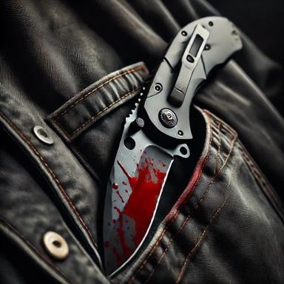
Blood on the Knife
Surprisingly, the investigation turned around when the detective found blood on the knife of the CEO's personal bodyguard. This knife, which was normally used for protection, was the evidence. The prime suspect in this case was now somebody who got paid to keep the CEO safe.
Why was there blood on his knife? Had he used it to save the
CEO during a struggle, or could he have committed the crime?
Investigators began to question his actions and motives.

Slide 22
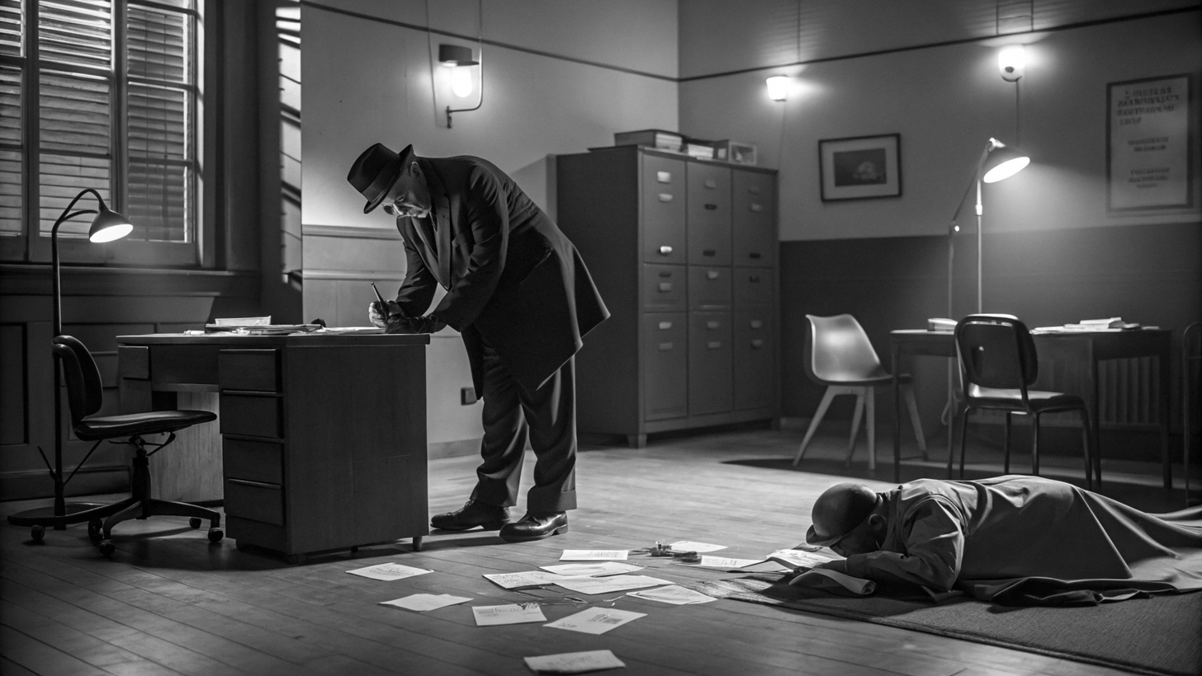

Detective: Can you explain what that is? (Shows the bloody knife)
Mac: It's just a knife, as you can see. Smirks Detective: (punches the table) Are you fucking kidding me?!?! Mac: Too obvious? hehe(Mutual silent glances...) Mac: Hey, I did not kill him. You know that, right? Detective: Didn't you? Then, explain the knife. Mac: How about asking your mom about that? Detective: (leans in, voice low and sharp) Listen, Mac, you're digging yourself
a deeper hole. Drop the jokes, or I’ll ensure you don’t leave this room anytime
soon. Mac: (leans back, crossing his arms) Alright, I’ll bite. It’s mine. Part of my
collection. Got it last week at a specialty store downtown.
Detective: (narrows eyes) So you’re admitting it was in your possession.
Convenient timing, don’t you think?
Mac: Yeah, it was in my possession—clean. I didn’t touch Milton with it. Hell,
I didn’t even see Milton that day.
Detective: Then how did the blood end up on your precious collectible?
Interrogation

Slide 23
Detective: (leans forward) And I suppose someone also forced you to sell out your boss to Crosswind Inc.?
Mac: (visibly startled) Whoa, whoa, who said anything about Crosswind? Detective: (smirks) You just did. Mac: (mutters a curse) Look, I was in deep, alright? They threw money at me, and I needed it. But I
didn’t sign up for this!
Detective: (voice hardens) Start talking, Mac. How much did they pay you? How long have you been
feeding them Blackthorn’s secrets?
Mac: (sighs) Five grand a month. For about three months. I gave them details—suppliers, contracts,
stuff they could use to undercut us. That’s it. I didn’t want anyone dead.
Detective: (points at the knife) And that? Mac: (shaking his head) I don’t know how it got like that! It's a collection piece. That blood is mine, I
swear!
Detective: (coldly) Or maybe you’re just scrambling because you got caught. Either way, you’re not
leaving this room until I get every name and every detail. Starting now.
Mac: (hesitates, then leans forward) Alright, fine. But you’d better catch whoever did this because it
sure as hell wasn’t me.
Interrogation

Slide 24

Contradiction in the Security Camera Footage
The technician had initially reported that no cameras were operational in the building at the time of the crime. Investigators found that only the camera in the CEO's office was malfunctioning, while all other cameras were fully functional. This begged the question of whether the technician was careless or misleading.
More suspicious was that the technician was close to the CEO's office
around the time of the murder. Why would he have assumed all
cameras were down?
Was this an attempt to protect someone, or another motive behind his
false claim?

Slide 25
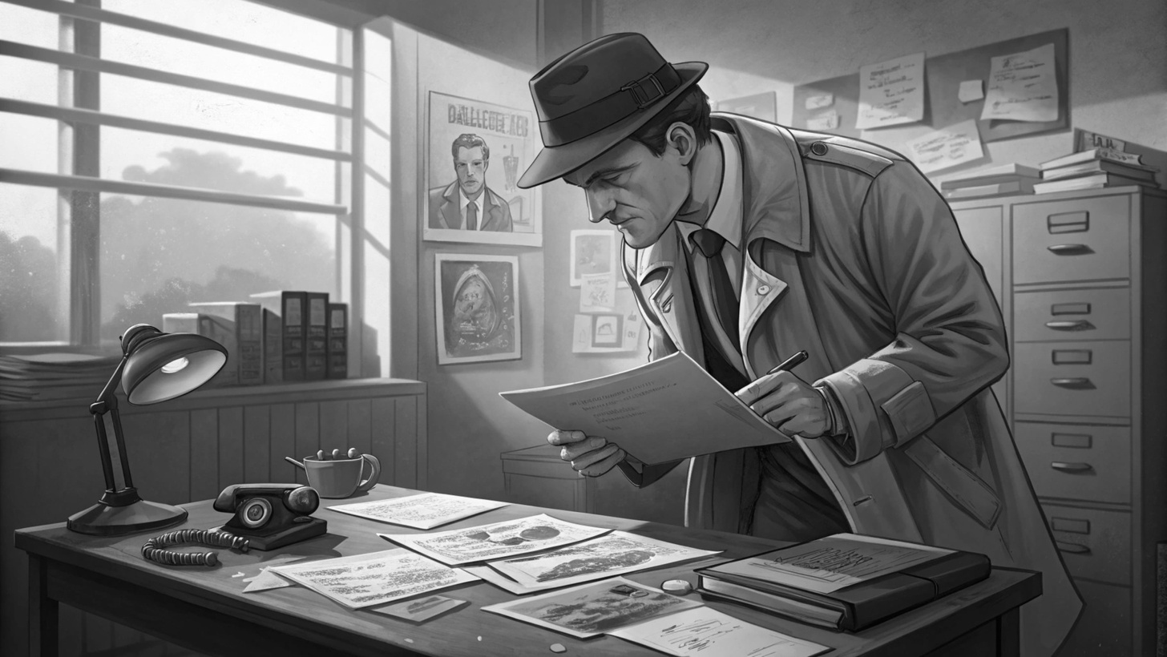

Detective: Your surnames are the same. Was he your brother?
Marcus: Not exactly. He was my cousin, but since our childhood, we
grew up together in the same family because his mom died in a car
crash when he was 4. After that, his father left him with my family
because he wanted him to live in a proper family.
Detective: I heard that your father was the former boss. Why aren’t
you in charge?
Marcus: I was supposed to be, but it would be much better and easier
if you asked my father about this.
Interrogation

Slide 26

Detective: Where were you at the time of the murder?
Marcus: I was on my way here but received an urgent phone call. I
had to go somewhere else before I came down here. There was no
answer when I knocked on the door, and the secretary wasn’t there.
Since he was my cousin, I opened the door, and that’s when I saw his
body. Detective: I investigated the camera recordings. You were indeed here
and didn’t leave the building. Care to explain?
Marcus: Yes, I was here. I was scared because I thought you would
suspect me when you learned about our past. That’s the whole reason
I lied. I didn’t kill him! I swear!
Interrogatio
n

Slide 27
All the Clues and Red Herrings
Drops of detergent near an unemptied bin.
Blood on the blade of the personal guard
False claim of Marcus

Slide 28



Who is the murderer?
Bonny Harper
Madison Alvarez
Mac
Marcus
Blackthorn

Slide 29
The detective put all the pieces together and realized that the suspect was Alvarez. The detergent stains on the edge of the trash and its unstable expression’s of her confirmed this. Alvarez said she forget to empty that bin, but there was evidence she went therei she tought she could blame Harper.

Slide 30
We used ChatGPT for pictures.

Slide 31
Verda Doğan Berke Kirez
Ozan Deniz Şahin
Berkay Fırat
Ecrin Eda Odabaşı

