Slide 1
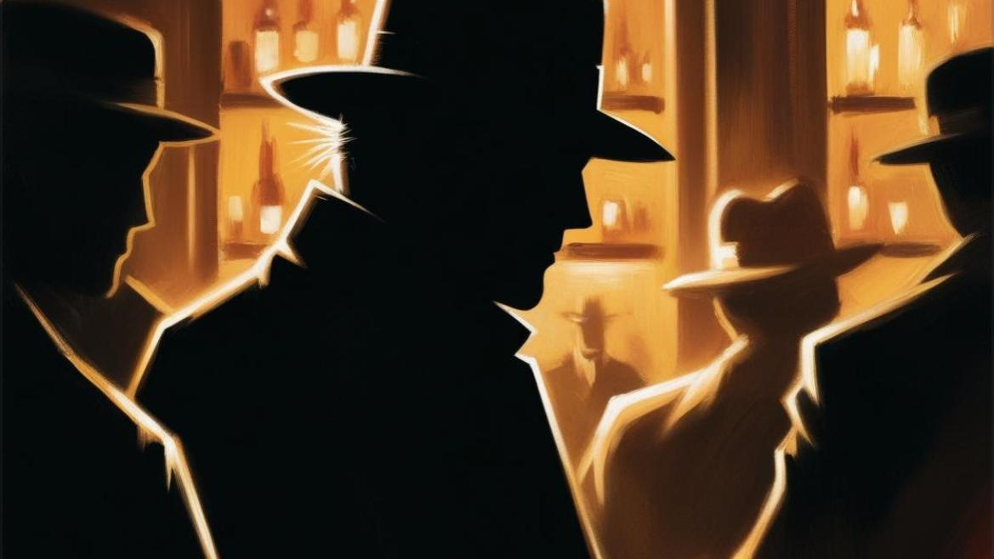
The Case of
Simon Fletcher
Yiğit Yılmaz
Mehir Miray Atıcı
Kutay Tomruk
Yağmur Kahraman
Ferhan Burgucu

Slide 2
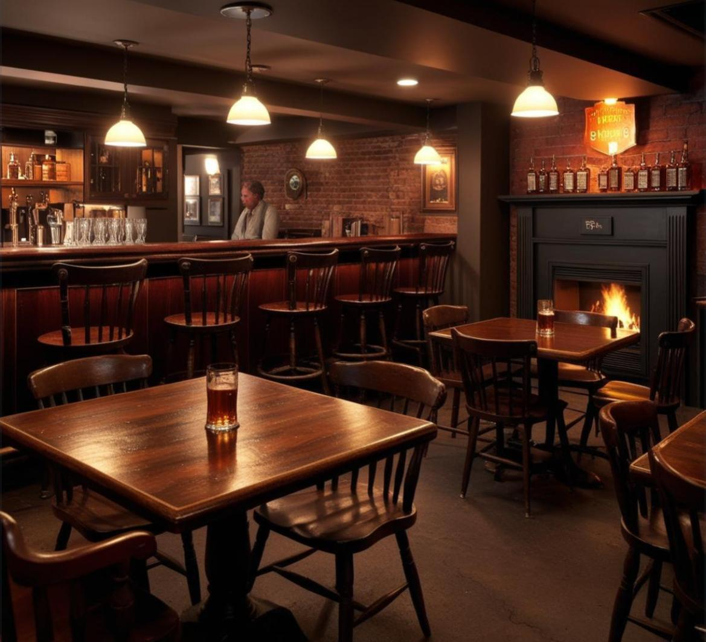
The Scene of The Crime
Location: Casey‘s Irish Pub
613 S Grand Ave, Los Angeles, CA 90017, USA
Time: 9.34 PM
• This place has a warm atmosphere, furnished with wooden tables and chairs, located in a basement. The interior design features a low ceiling and dim lighting. A fireplace enhances the cozy feel of the bar. In the background, the bar counter is decorated with wooden shelves, stocked with a variety of drinks.

Slide 3
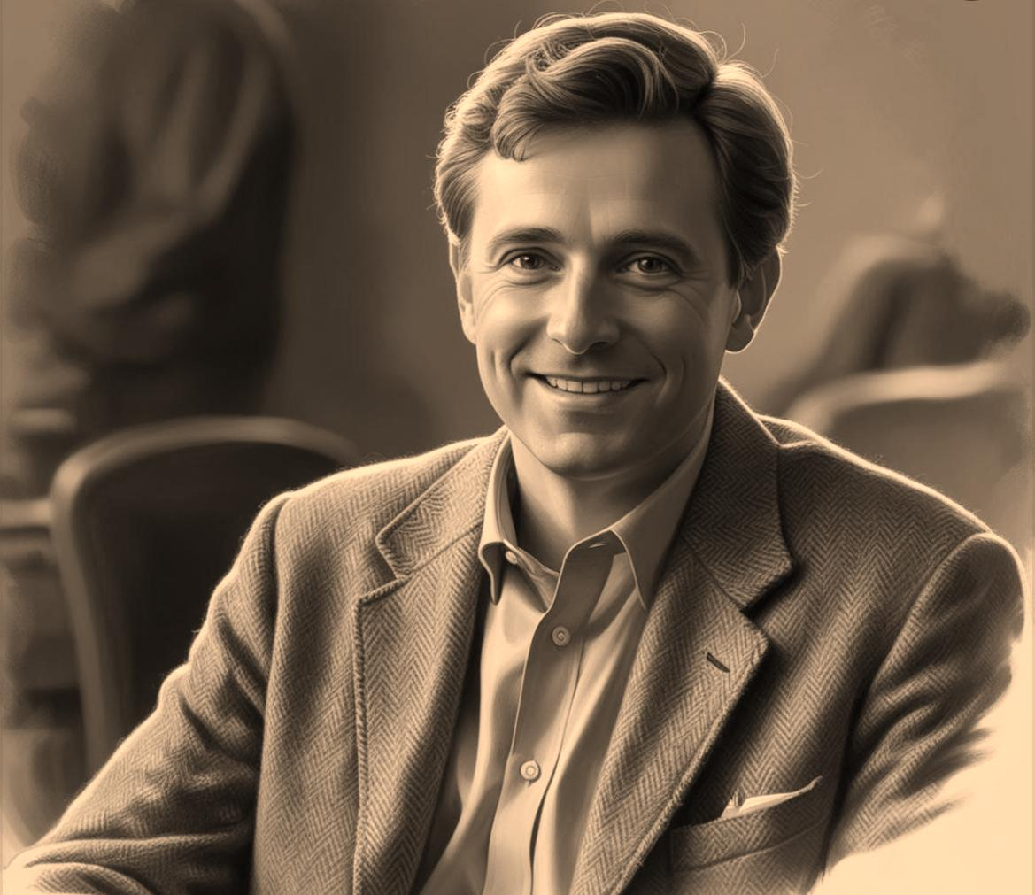
Who Was the Victim?
Name:Simon Fletcher
Age:49
Occupation:Philosophy Professor
He was a very good friend of Dr. Adrian Blake, they were high school friends.
He knew two of the suspects.

Slide 4
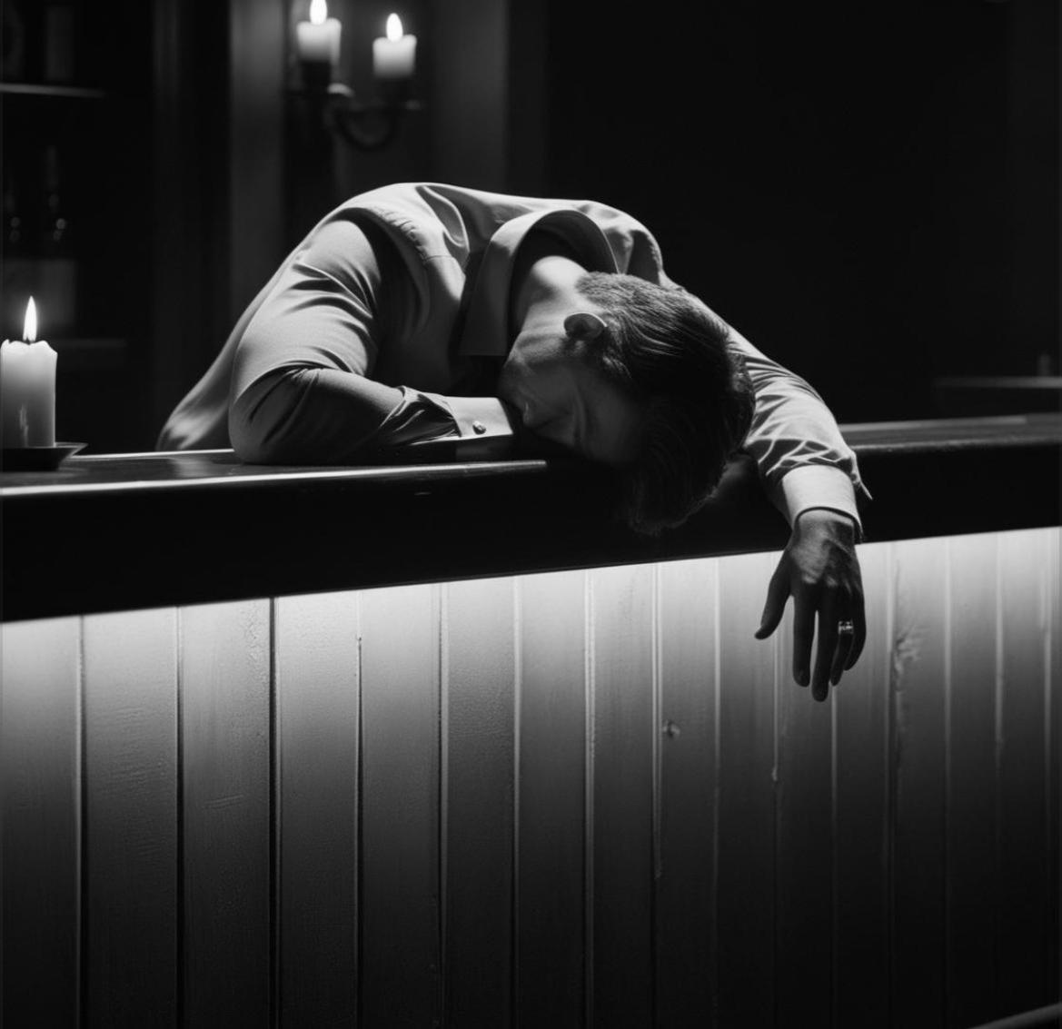
What Happened?
Adrian Blake and Simon Fletcher were high school friends, they went drinking at the same place on the first Friday every month. This month they entered the bar at 7.46 PM. They sat to their usual place, next to the bar. They ordered some drinks, started chatting. At 9.14 PM, Irina Volkov, misstress of Adrian Blake, walked in furiously. She told Adrian that she was pregnant with his baby. When Simon heard this he got very angry because he was very disappointed about his friend. He yelled at Irina and pushed her off. There was a tense atmosphere in the bar. Some people got disturbed and went away to another bar. Irina started crying and walked to the restroom.
At 9.34 PM, the lights went of and a yelling sound came. Everyone started screaming. After 5 minutes, the lights turned on again, everything was in place, except Simon Fletcher. He was stabbed from his neck and arm, bleeding and dead... There was a mysterious satin glove on the ground...

Slide 5

DR. ADRIAN BLAKE
• Age : 49
• Job : Oncologist / Cancer Specialist
• Victim’s old high school friend
• Married to a 45 year old woman
• He has a 15 year old son
• He is a clever, wealthy person and a well known doctor in his major
• He is not loyal and he doesn‘t take care of his son but he is a good friend

Slide 6
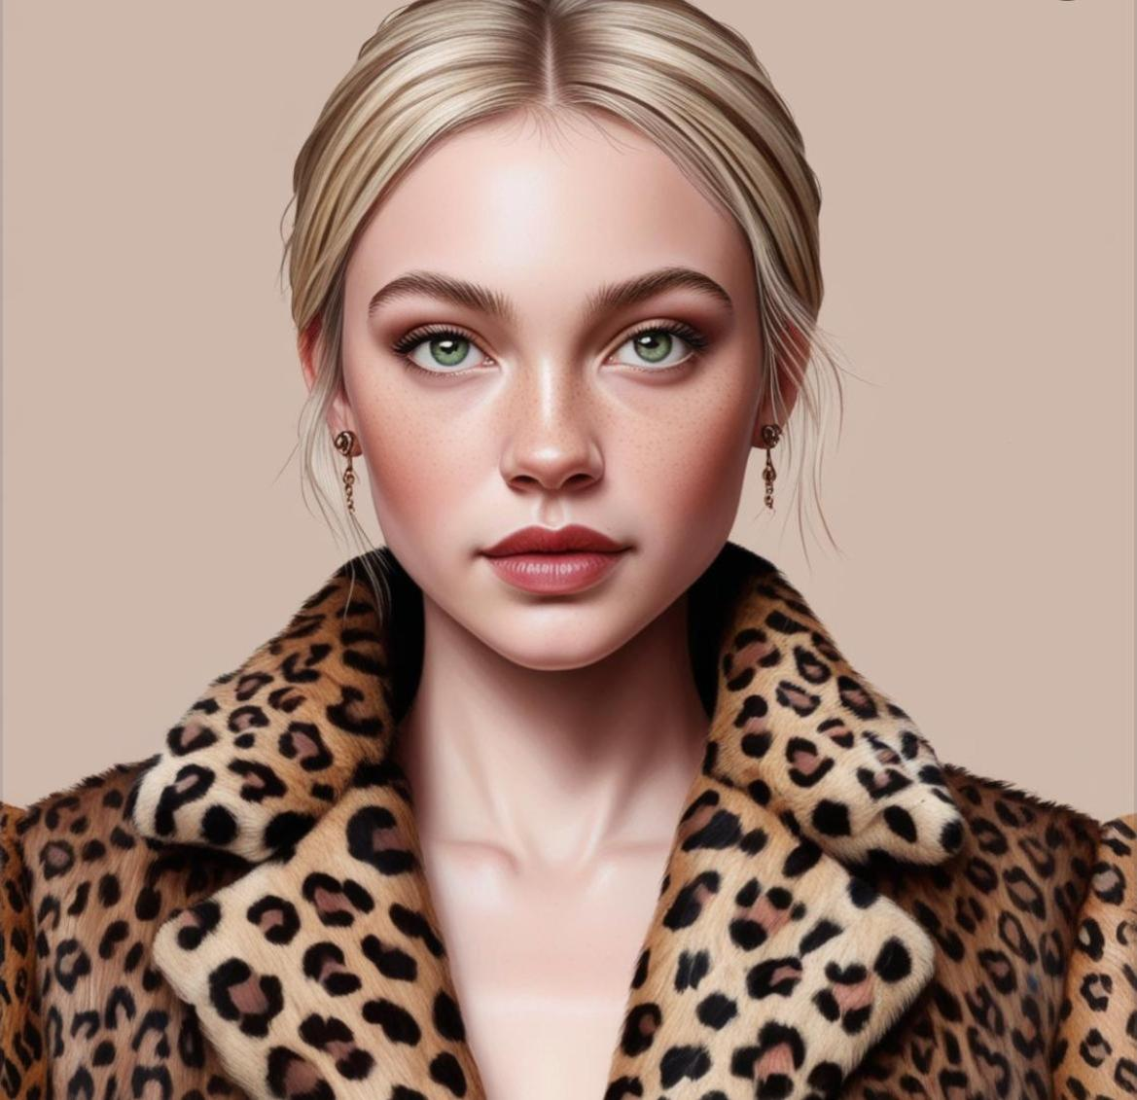
IRINA VOLKOV
• Age : 23
• She is an immigrant from Russia
• She migrated from her country because she has debt to mafia
• She is living in the country legally
• She is Dr. Blake‘s mistress
• She is in love with Dr. Blake
• Life made her become a rough person
• She is good liar
• She is 3 months pregnant

Slide 7
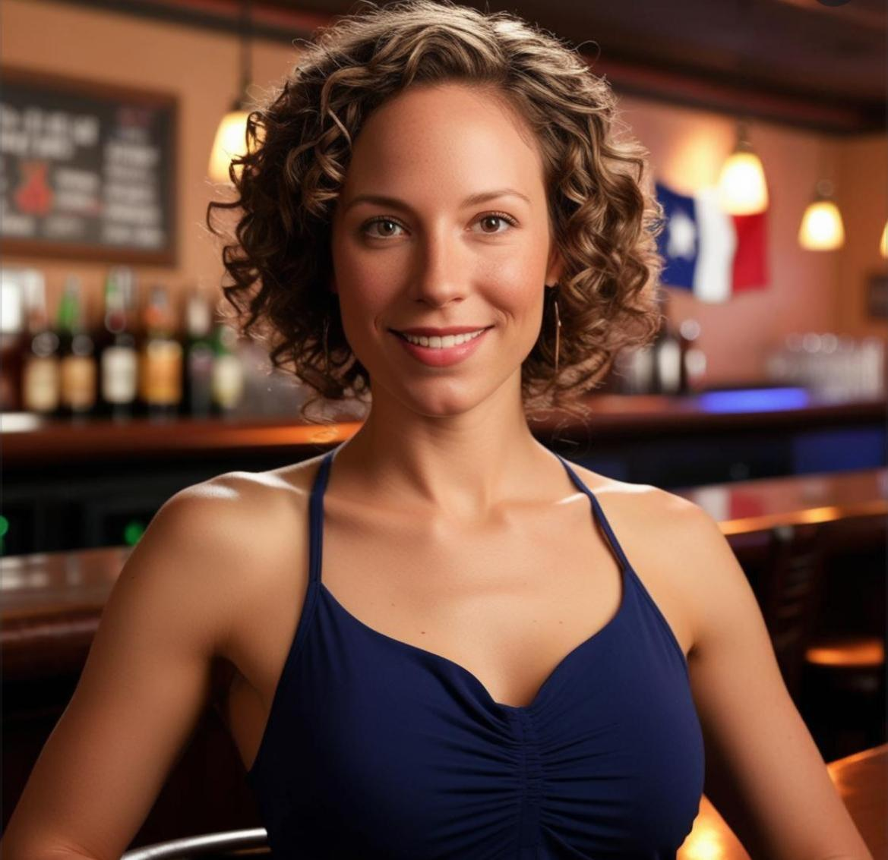
SANDY HARPER
• Age : 29
• Job: Barmaid
• She lives in Los Angeles with her mother alone
• She was in jail for 5 months when she was 25 years old
• She dropped out of Law school because of her father‘s health conditions, she needed to work as a barmaid
• She is extremely friendly but she is very vindictive

Slide 8
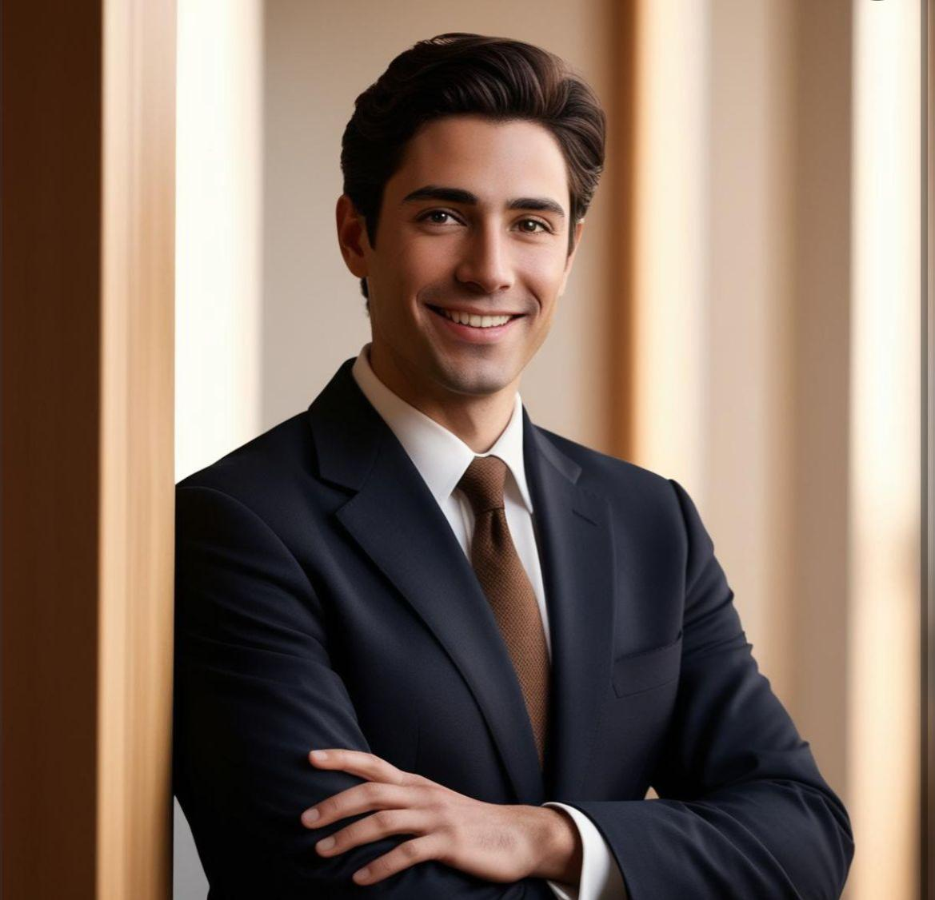
Lorenzo Ricci
•Age: 30
• Job : Lawyer ( usually works about immigrants)
• He is originally an Italian but he was in the U.S. since his birth
• He is a regular customer of the Pub
• He has a clear conscience but he is a bad tempered person

Slide 9
Investigation of Adrian Blake
D: Welcome Mr. Blake, I am going to ask you a few questions about the crime scene.
Mr Blake: Thank you Detective, of course, I am here to help you find my friend’s murderer.
D: Firstly, What were you doing in the bar?
Mr Blake: Simon and I get together and have a drink in this bar every month. That day wasn’t any different than the previous meetings despite he asked to meet me 1 week earlier.
D: There was an argument before the murder, do you think there is a connection between them? What was the argument about? Do you know Irina Volkov
Mr. Blake: Irina and I had just a one night stand approximately 6 months ago. Our only other interaction happened 4 months ago, she came to me and said that she was pregnant. She wasn’t, she is a liar and a gold digger. She threatened me about telling the incident to my wife. She came and did it again that night, Simon and I got angry so we had an argument with her. It was a mistake that happened 6 months ago, I love my wife and kid and I don’t want to deal with this anymore.

Slide 10
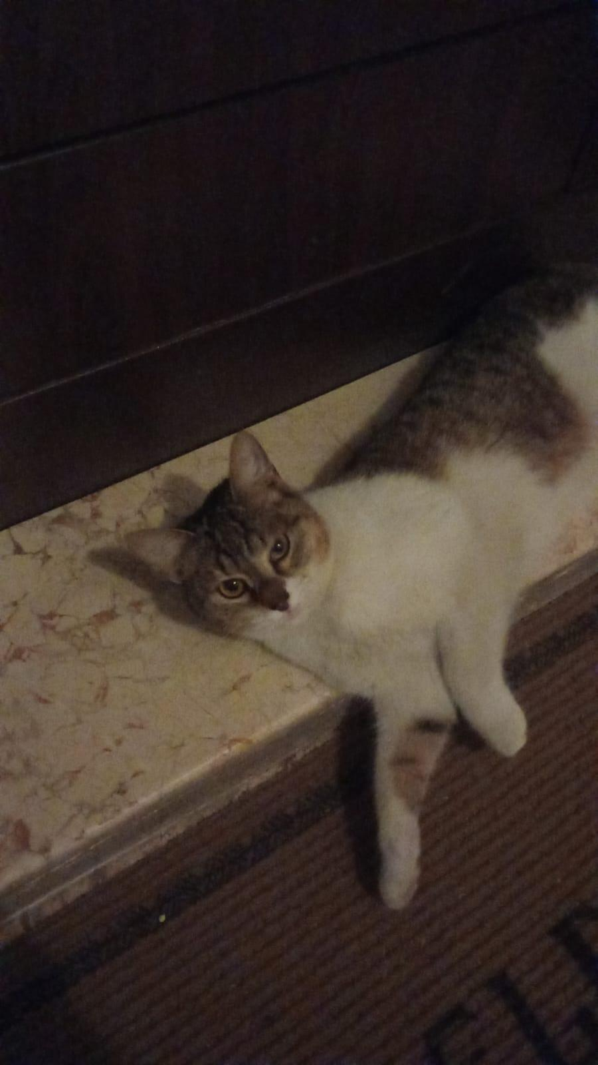
D:Can you describe me the crime scene?
Mr. Blake:It wasn't long after Irina left our table that the lights went out. I was just reaching for my wallet that fell to the floor. Shortly after, someone bumped into me, causing me to lose my balance on the chair and I found myself on the ground and shouted. Then, I heard my dear friend screaming in the darkness. I think the person who bumped into me wasn't very large. When the lights came back on, my friend was lying there, covered in blood, stabbed in the neck.
( Detective shows the glove that has been found in the crime scene to Adrian )
D: Do you have any idea whose this might be?
Mr. Blake: hmm... Let me check...
( Detective shows him the glove closly)
Mr. Blake: This is exactly something Irina would wear but I‘m not quite sure if this belongs to her
D: Okay, i think that‘s enough for now. I’m sorry for your loss.

Slide 11
Investigation of Irina Volkov
D: Welcome Mrs. Volkov, I invited you here about Simon Fletcher’s murder. You were at bar when crime scene happened? What were you doing there? Can you tell me what you remember?
Irina Volkov: I am so sorry about Simon’s death. He was a very good person despite our argument that night. I was at the bar because I had a meeting with my lawyer Lorenzi Ricci
( Detective shows the glove that has been found in the crime scene to Adrian )
D: Is it possible this glove might be yours?
Irina Volkov: Ohh... Yes they were my favorite pairs, I‘ve been looking for them since that day but where is tiiinvestigation.
D: Is there a possibility that you might have dropped them while you were having the argument?
Irina Volkov: Net, I got them off when I first arrived. They were on the table.
• D: What was the argument about?
• Irina Volkov: I was sitting with my lawyer in the bar,I had seen Adrian at first but I didn’t want to disturb them.But I heard Adrian telling Simon that he was planning to break up with me so I got angry and said I was pregnant. Normally I was going to tell him later. After our argument I went to the restroom to cry.
• D:I need a proof for your pregnancy, please do this test I will give you and come back tomorrow for the rest of the investigation.

Slide 12
THE OTHER DAY…
D: I got your test result and it’s positive but I am not sure if the baby is Adrian’s because you are married to someone else.
Irina Volkov: No, father is Adrian. My husband and I had a convenience marriage. Neither my marriage is related to this topic or I am not related to the murder. I didn‘t even had a conversation with the victim despite that day. Also he shouted at me first that day, I am a pregnant woman he is stealing my role.
D:You told me Simon was such a good man yesterday, but you suddenly changed your opinion about him. Why?
Irina Volkov: I have nothing to do with this murder. I don‘t know why you keep asking me these questions I‘m also pregnant and you’re giving me a hard time here. I don’t want to keep talking anymoogh...
°Irina lefts to throw up°

Slide 13
(Detective goes to check on Irina)
D: Are you okay Mr. Volkov?
Irina Volkov: No I‘m not okay! I’ve been keep telling you that I am pregnant. Didn‘t you see? I’ve been throwing up for many days. I don‘t want to be invested anymore. I want my lawyer. I am not talking without my lawyer anymore!!

Slide 14


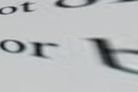
Investigation of Lorenzo Ricci
D: Hello Mr. Ricci, you’re here as suspect of the crime. I want you to tell me everything you know about that night.
Lorenzo Ricci: Hello detective, sure let me tell you. I met with Irına at my go-to pub. We were just talking about a legal issue about green card because I’m her lawyer. I don‘t have anything to do with the murder. When the lights went off, I was on my way to the restroom to see if my wif...
D: Wife?!
Lorenzo Ricci: Didn‘t you know? What kind of a detective are you?
D: I knew she had a husband but she never mentioned it was you. When did you get married? Do you have an idea why she did not mention this?
Lorenzo Ricci: We met with Irina 3 years ago because she needed a lawyer. She was an immigrant and the only way she could stay in the US was getting married. I unfortunately fell in love and couldn’t resist the urge of not wanting her to go so I got married with her. She doesn’t know this and doesn’t want anyone to know we are married because she is in love with Adrian Blake and carrying his baby...
D: So are you confirming that the baby is Adrian’s, right?
Lorenzo Ricci: I already told you that it is! If you keep going like this, how do you plan to find the killer in your investigation? You probably haven‘t even figured out that Adrian is the killer yet.

Slide 15
D: Why do you think Adrian is the murderer?
Lorenzo Ricci: Don‘t you already know he killed someone before? (in a sarcastic tone)
D: What do you mean by that?
Lorenzo Ricci: One of my client’s father passed away because of his wrong treatmant I am sorry but I can‘t tell you more because of the protection of personal information.
D: Okay, Can you tell me what happened while you were going to the restroom at the exact moment of the murder? Did you see anyone or hear anything?
Lorenzo Ricci: I saw the bartender is changed before the lights went off, I heard noises and someone screamed.
D: Thank you, that‘s enough but one last thing. Do you know whose these gloves are?

Slide 16
Lorenzo Ricci: Ummm, I have never seen them before.
D: How, Irina said that it was hers? You should have seen it that night.
Lorenzo Ricci: Like I said before, I have never seen them. Why is this so important? I‘m leaving.

Slide 17
Investigation of Sandy Harper
D: What happened that night? Where were you?
Sandy Harper: My shift was finished so I went to the staff room to change my clothes. While I was dressing up, lights went off. I don’t know anything else. Why are you questioning me instead of John? (Other barmen)
D: You worked at the crime scene for a long time,until the time of the murder and the shift change. Additionally you have 5 month prison history due to theft, could you give me some information about it?
Sandy Harper: My dad had stage-4 cancer... Unfortunately we lost him
D:I‘m sorry for your loss.
Sandy Harper: We needed money for his treatment. So I tried to rob the nearest goldsmith to me. I know it was a mistake, I was young.
D: I see that you were released earlier than you should. How did that happen?
Sandy Harper: My old friend Lorenzo from law school helped me who is a good lawyer now

Slide 18
D: Lorenzo... Lorenzo Ricci?
Sandy Harper: Yes.
D: He was at the crime scene. Did you see him that night?
Sandy Harper: Hmm.... Yes I think so... He was going to meet with his wife.
D: Do you want to add anything?
Sandy Harper: Yes... By the way, I think the murderer is that stupid doctor who killed my dad. The God d@mn person couldn’t even manage to die. I hope that the murderer gets its fine.
(Sandy cried in 1 minute of silence)
• Sandy Harper: My father was very sick, he was dying from cancer,. We didn’t have any money so I needed to take care of my father and for this reason I‘ve dropped out of Law school. Then I’ve searched for jobs but no job was adequate to afford the medical expenses. You know the rest...
D: Again I‘m sorry for your loss but you should help me out here. Why do you think Dr. Blake killed your dad? Was he your father’s doctor?

Slide 19
Sandy Harper: I have searched for many doctors in the city and then they suggested me Dr. Blake. My father and I went to Dr. Blake he said that my father had no chance to live anymore and he did not do the right treatment to him.
D: Could he have died of natural causes? Are you sure?
Sandy Harper: No! You don‘t know anything. I’ve been through so many things okay?! I am telling you Dr. Blake did it. My father could‘ve survived if that so called Dr. Blake did the right treatment.
(Sandy starts to get nervous and speak loudly then detective sees a scar on her right hand)
D: What is this scar on your hand? Where did this happen?
(Sandy quickly hides her hand with her sweater)
Sandy Harper: It‘s nothing... Umm.. It happened the other day when I was cooking.
D: Lastly, this glove was found in the crime scene. Do you have any idea?
Sandy Harper: Oh, I think it is Irina‘s. I saw it when she came to ask me not to put alcohol in her coctail.
D: Okay Sandy, this is enough thank you.

Slide 20
Second Investigation of Adrian Blake
D:Welcome back Mr.Blake, there are some extra question I need to ask for investigation, this is why I called you back.You told us Irina is not pregnant but it turned out she is, do you have an explanation?
Adrian Blake:(He turns red)Okey, I lied because I didn‘t want to get a divorce and wreck my family.
D:Can you explain me what happened to George Harper?(Sandy‘s father)
Adrian Blake:He was very near to death amd I tried my best,unfortunately he couldn’t make it.However, his daughter is accusing me for his death.Also she sent me several life threating letters and her lawyer Ricci said that they were going to sue me but naturally they couldn’t find any evidence.

Slide 21
DETECTIVE’S THOUGHTS
“The doctor can’t be the murderer because he was lying on the floor when the lights came on. Irina can’t be the murderer because she was in the restroom but she may know something or helped the murderer. Sandy could have helped too. Adrian claims she was threatening him but what is the connection to Simon? Lorenzo… he’s the most suspicious one. But the doctor lied about Irina, which also makes him suspicious. Actually he explaned why he lied. The murderer can’t be just one person because, besides the killer, someone had to turn off the lights. Sandy… My fathers hand. He burnt his hand while changing the bulb. What she had on her hand didn’t look like a heat burn ; it looked like an electrical burn. She must have been the one who turned off the lights. However, the doctor definitely can’t be the murderer because he was found collapsed on the floor, and if he wanted to kill his friend, he wouldn’t choose such a crowded place—he’d pick somewhere easier, like Simon’s house. The glove... The glove... Since no fingerprint was found, the killer may have used Irina’s gloves to stab her. However, the glove found at the crime scene was not bloody, and the other one is missing. It is likely that the missing glove was bloody and was used during the murder. The murderer is ................ Of course. How didn‘t I realize this before.

Slide 22
The True Story of the Incident
When Adrian and Simon made a reservation at the bar, Sandy immadietly şnformed Lorenzo, who already knew that his wife Irina was pregnant, felt resentment and jealousy towards Adrian and planned to kill him with Sandy‘s help. Sandy agreed to the plan because she felt indebted to Lorenzo and hated Adrian. During the shift change, Sandy would turn off the lights, and Lorenzowouldstab Adrian. However, things went wrong when Adrian bent down to pick up his wallet, and instead of Adrian, Simon –an innocent professor just trying to make a living- became the victim of their malicious plan.
To avoid leaving fingerprints on the knife, Lorenzo noticed Irina‘s gloves on the table and then picked up the other items as if he were leaving the bar, and in doing so, the other glove fell to the floor.

Slide 23
Afterwards, Lorenzo threw the bloody gloved hand into his pocket and went inside to restroom.
The person who was actually supposed to be killed Adrian Blake, but Simon was accidently killed instead...

Slide 24
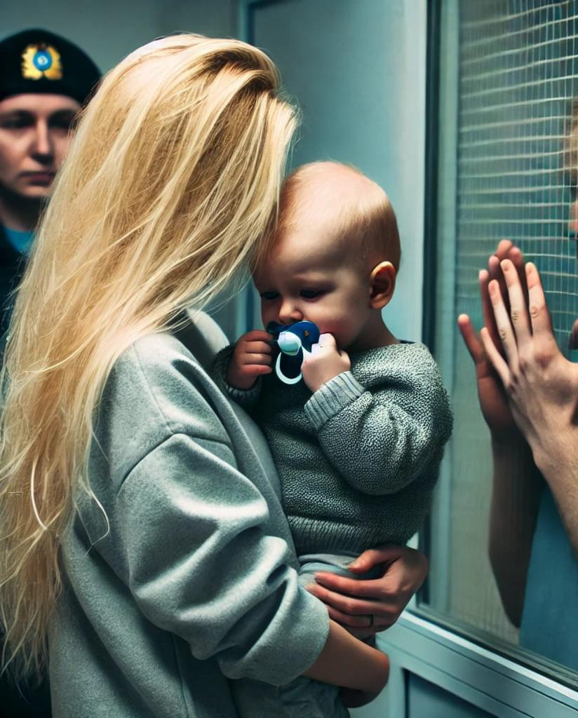

Slide 25
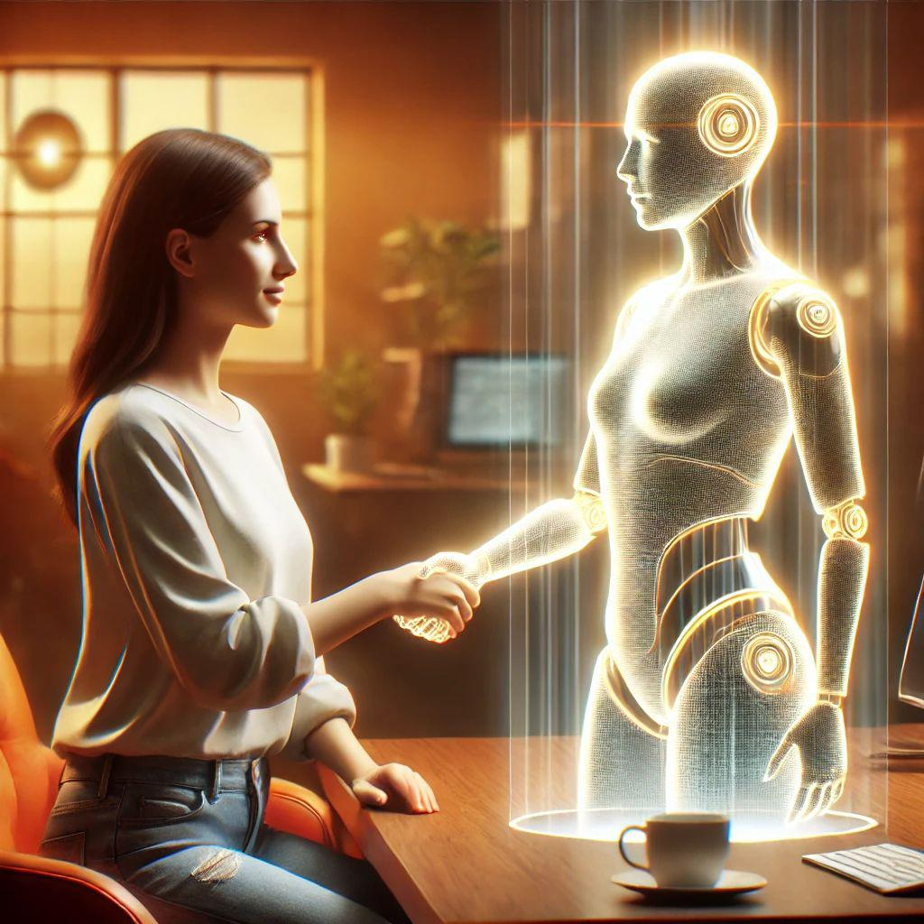
«In this presentation ChatGPT was used for creating images»

